Slide 1
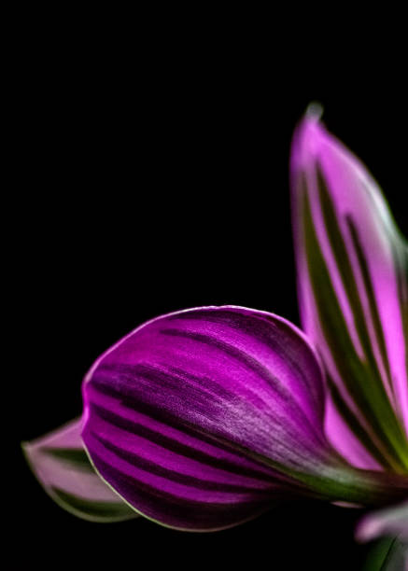
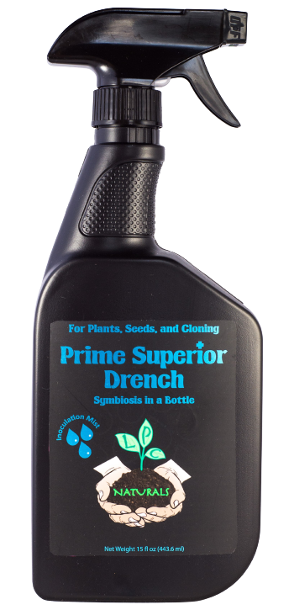
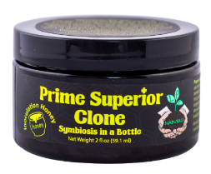
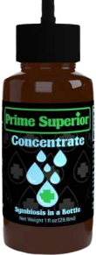
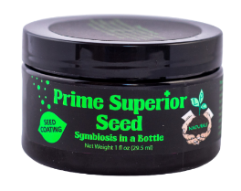
Symbiosis in a Bottle
Grow Superior not inferior

Slide 2
House Plants look and grow better
Brings a shine to your leaves!
Establishes a beneficial symbiosis that can improve plant growth.
Larger root systems
More attractive leaves
Thicker stems
Darker green color
Increased growth
More biochemicals

Slide 3
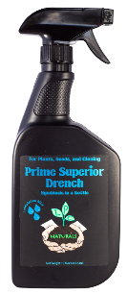
We designed the Prime Superior Range to have a product you can use whatever you grow!
Prime Superior Clone:
For Cloning:
The World’s first Inoculation Honey.
Prime Superior Seed:
For Seeds:
Seed coating.
Prime Superior Drench:
For all plants, young and old:
Versatile spray product
Prime Superior Concentrate:
For larger commercial grows:
Concentrated liquid

