Slide 1
The Prime Superior Range was established for indoor growers including produce and house plants
Products are safe and can be used by organic growers
Natural symbiotic interaction can improve plant growth
Contact Us
Dr. Paul Rushton
(President and Chief Scientific Officer)
(716) 633 1940 EXT 333
https://primesuperior.com/

Slide 2
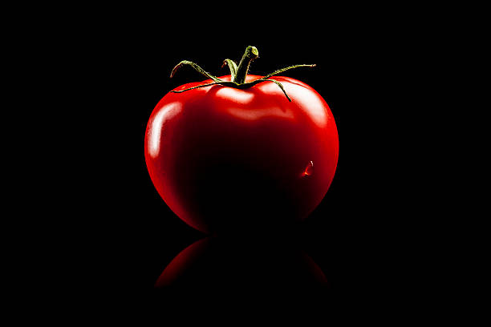
Produce grows better
Growers have seen
Increased sweetness (Brix Scores)
Increased yields
Larger root system

Slide 3
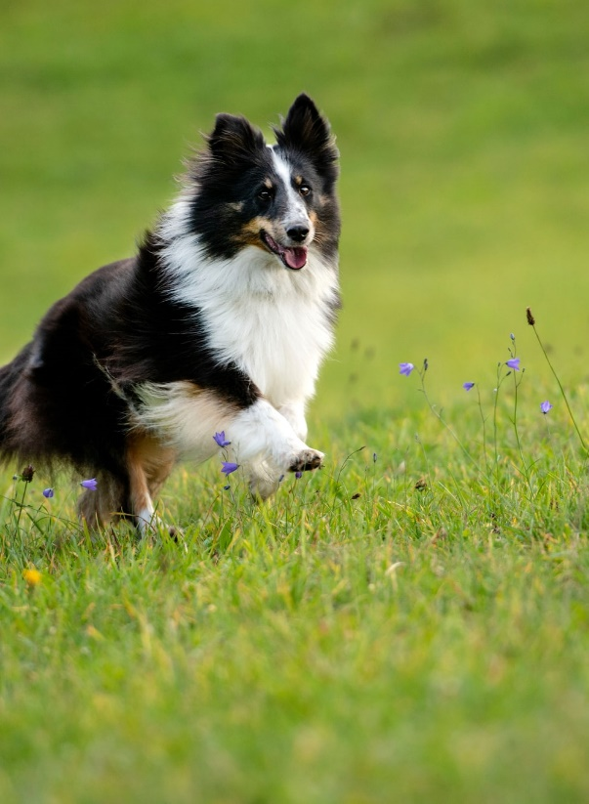
No more warning signs
PRIME SUPERIOR products are safe!
Safe for people
Safe for your pets
Safe for the environment
Grow without the worry

