Slide 1
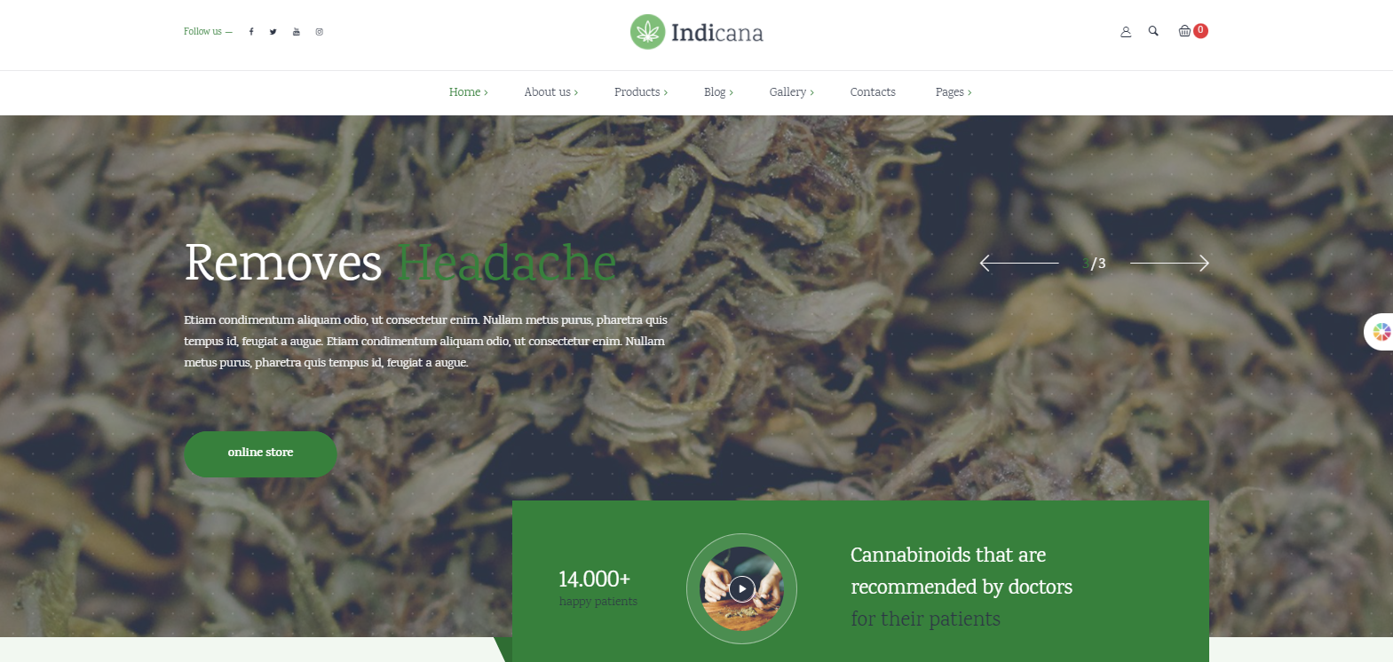
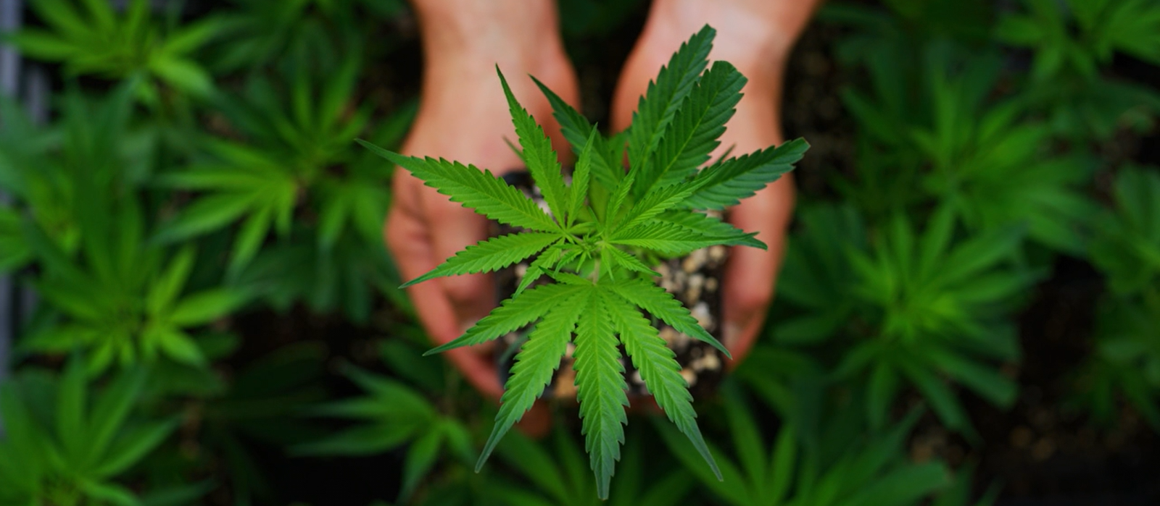
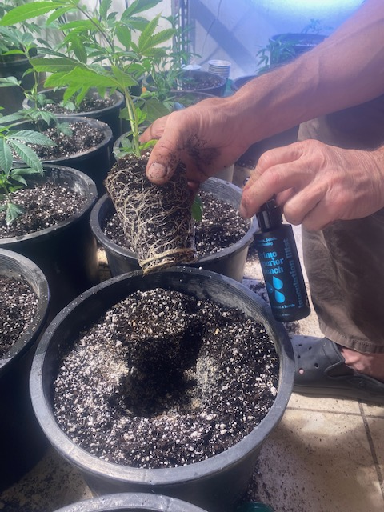
Science
Contact Us
Wall of Fame
The Safe Future of Indoor Growing
Symbiosis in a Bottle
Trials showed:
15-25% more cannabinoids
109% more terpenes
Higher Yields
Better Quality

Slide 2
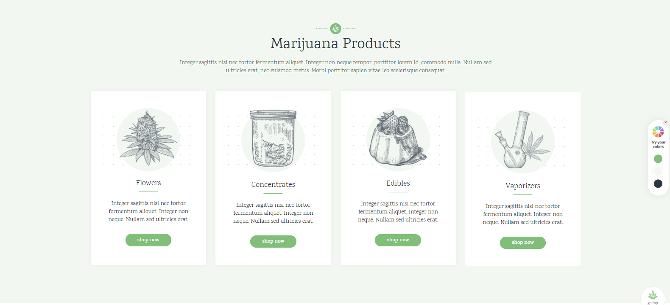
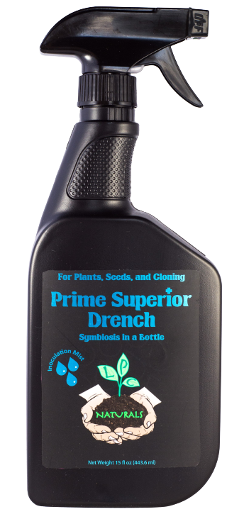
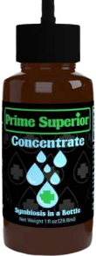
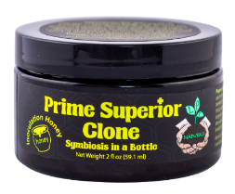
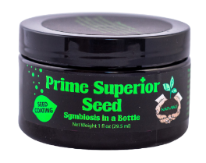
Grow Superior!
We designed the Prime Superior Range to have a product that will improve your plants however you grow
Prime Superior Clone
Prime Superior Seed
Prime Superior Drench
Prime Superior Concentrate
For Cloning
World’s first Inoculation Honey
For Seeds
Seed coating
For all plants, young and old
Versatile spray product
For larger commercial grows
Concentrated liquid

Slide 3
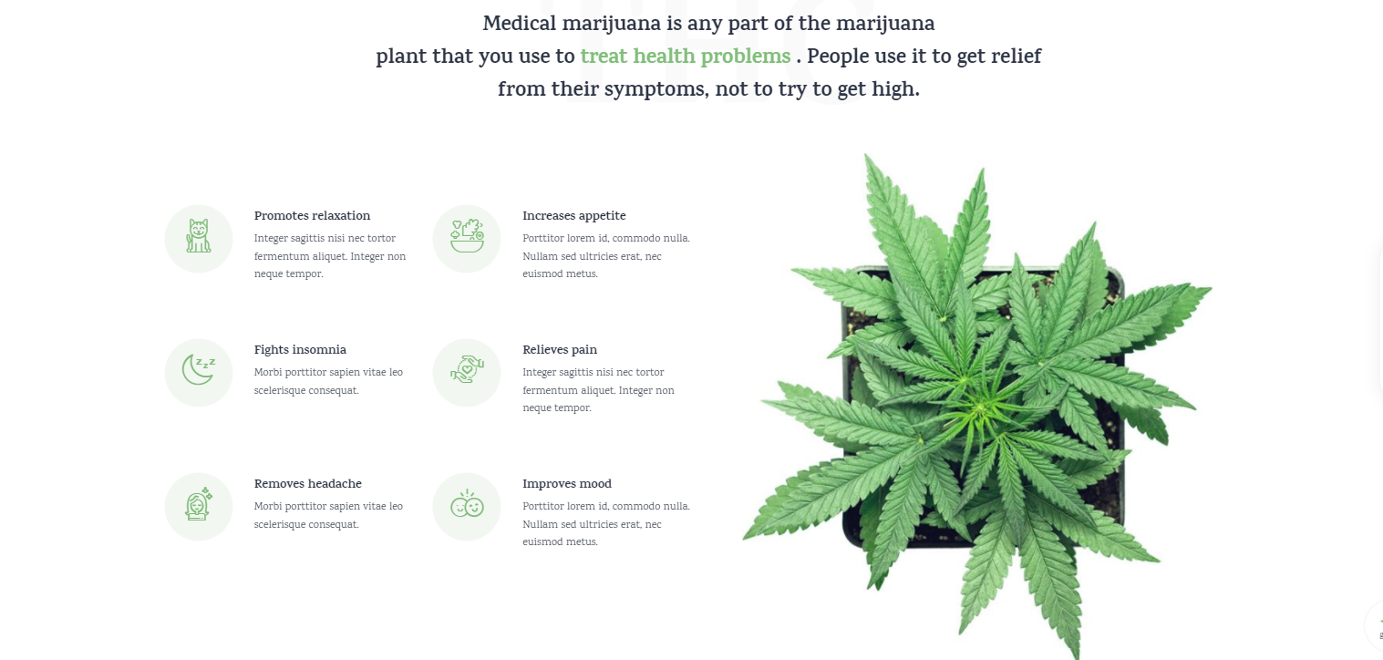
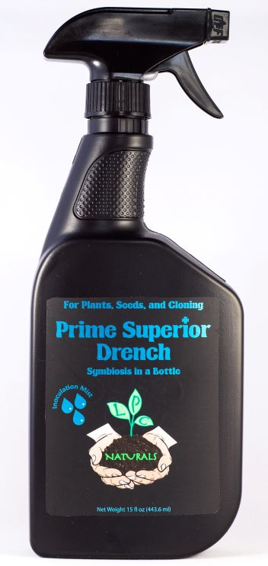
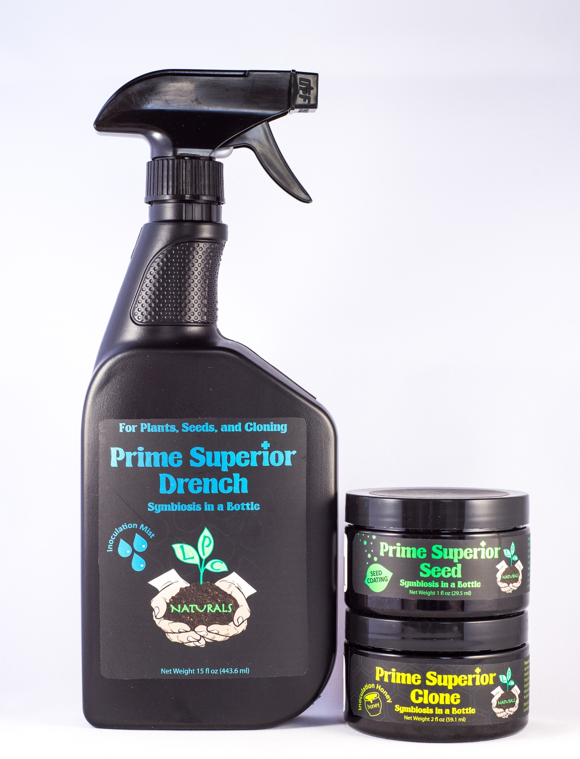
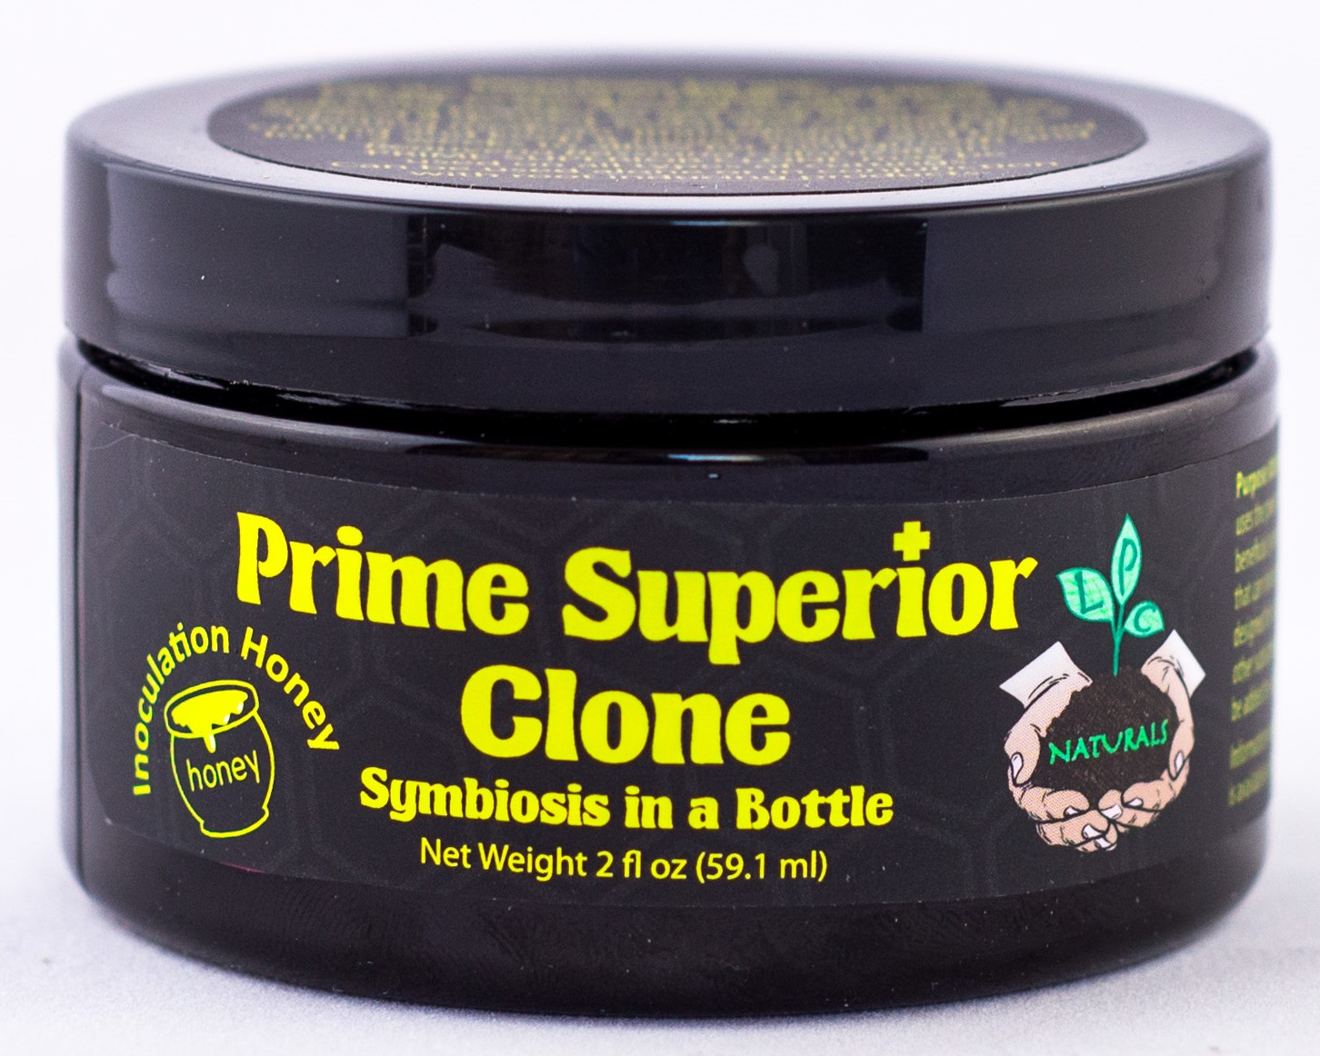
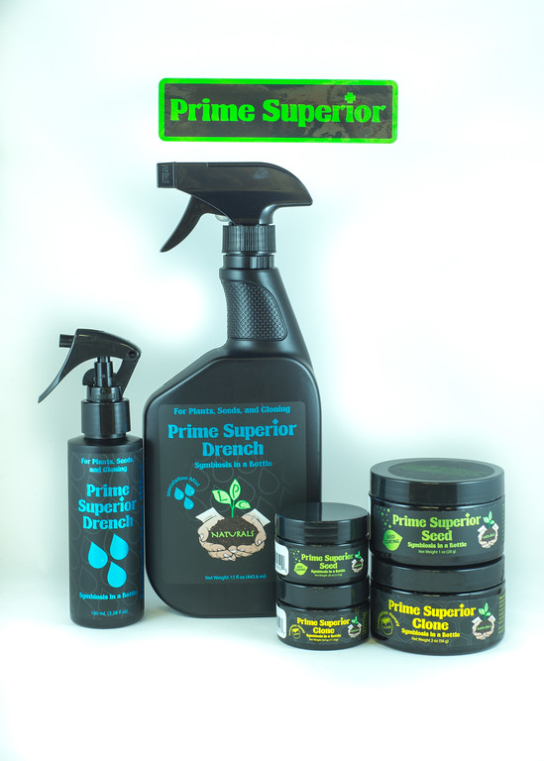
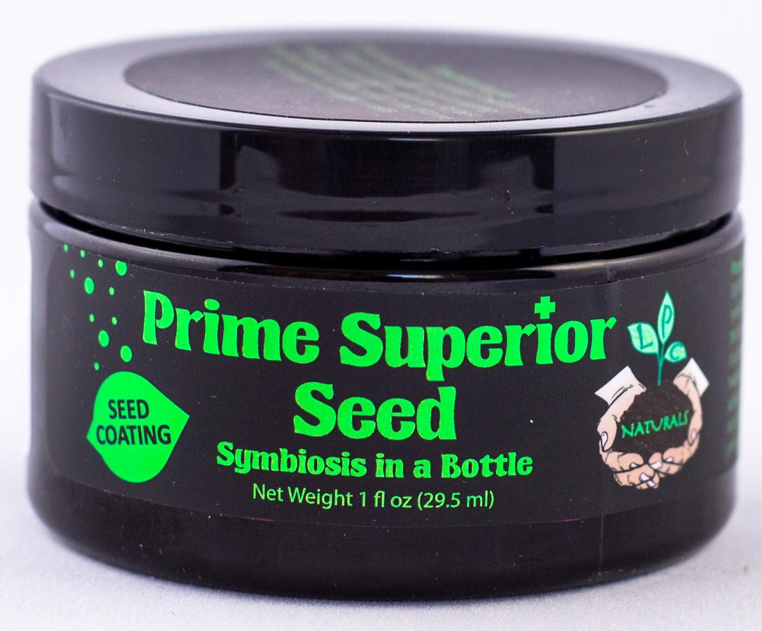
What is Beauveria bassiana?
The Prime Superior Range of products contain our proprietary strain of Beauveria bassiana.
Beauveria bassiana is a safe fungus that grows naturally in soils throughout the world.
It forms a symbiotic relationship with plants that can increase yields and quality.
More Cannabinoids
15-25% increases in CBD, CBC, and CBG seen in field trials
More Terpenes
109% increase in total terpenes seen in field trials.
Many went from undetectable to detectable
More Growth
Treated plants were bigger with larger yields
More Photosynthesis
Treated plants had a better color and more photosynthesis
Larger Flowers
Treated plants had bigger flowers
Larger Root System
Treated plants had larger root systems

Slide 4
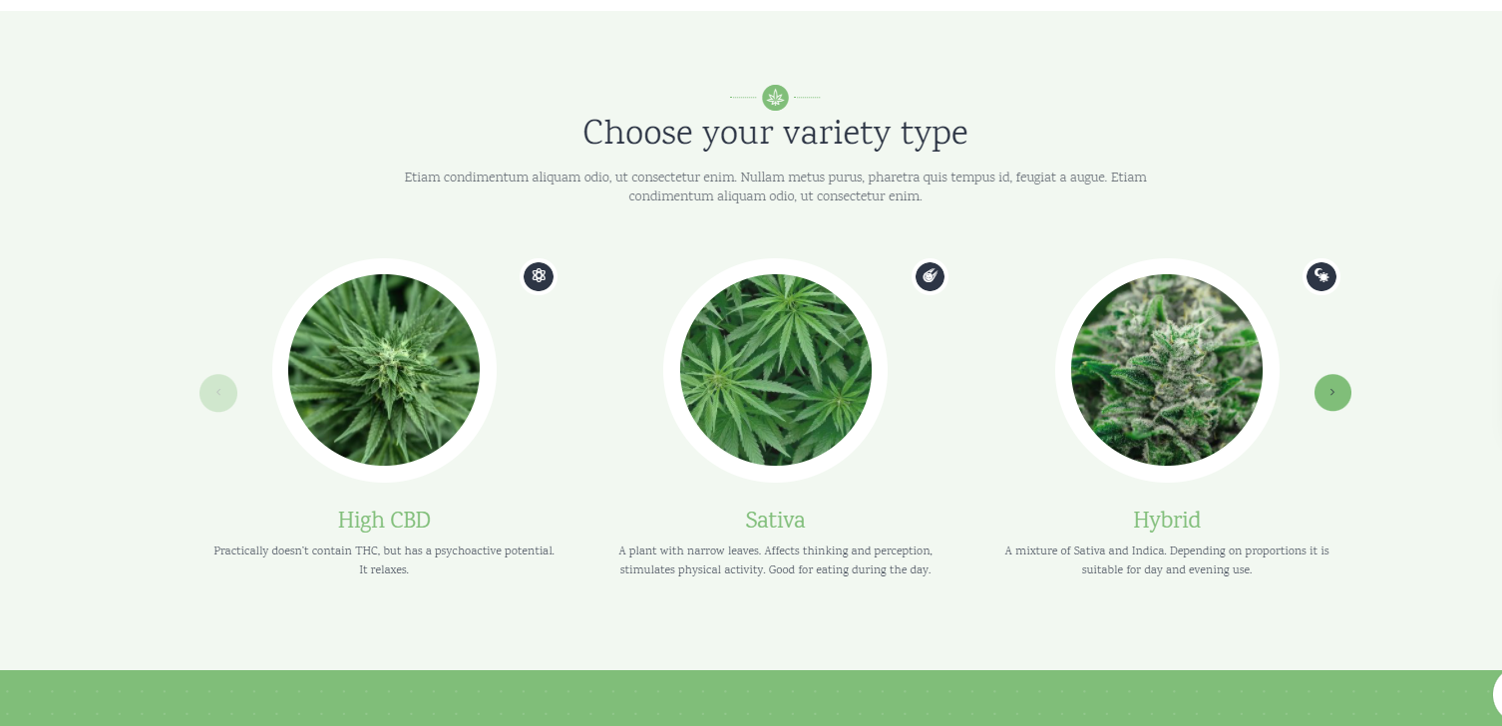
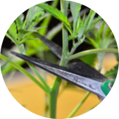
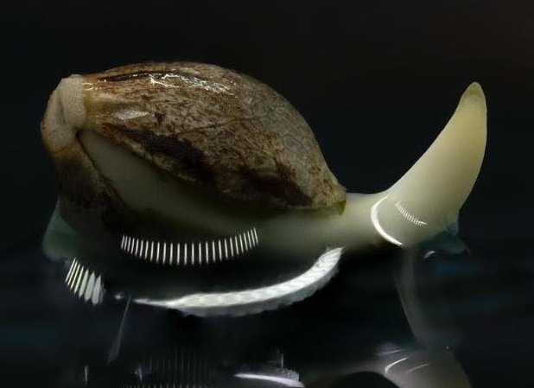
Choose Your Grow
We designed the Prime Superior Range to have a product you can use whatever and however you grow!
Clones
Seeds
Adult/Mother Plants
Create the best clones with Prime Superior Clone.
The world’s first inoculation honey.
Growing superior plants from seeds with Prime Superior Seed is extremely simple and quick.
Your adult plants benefit immensely when treated with Prime Superior Drench, especially mother Plants

